Slide 1
Set Top Box Multiplayer Framework
Team: Plugged-In
Sponsored by: Innovative Systems, L.L.C
Notes:
(30 seconds) Introduction – Marshall introduces the team, each person introduces themselves
Marshall

Slide 2
Brief Overview and Project Goals
Create a server to host multiplayer game plugins
Design a template game UI for STBs in an APMax environment
Build a virtual APMax to simulate future communication protocols.
Convert currently existing games to proof-of-concept multiplayer games.
Notes:
David Jarman

Slide 3
Scope of Project
Proof-of-concept
Deliver two working games
In house
Server and games environment will be privately hosted during development
Notes:
Scope – 30 seconds
David

Slide 4
User Stories
No STB software changes after initial release
Client-server architecture to host and deliver “plug-in” games
Player vs. Player, Player vs. AI, single player
Server hosts game logic, STB host game UI
Support 100s-1000s of users
Secure communication between server and clients
Full unit testing
Notes:
User Stories: 1-2 minutes
Kevin – needs refinement

Slide 5
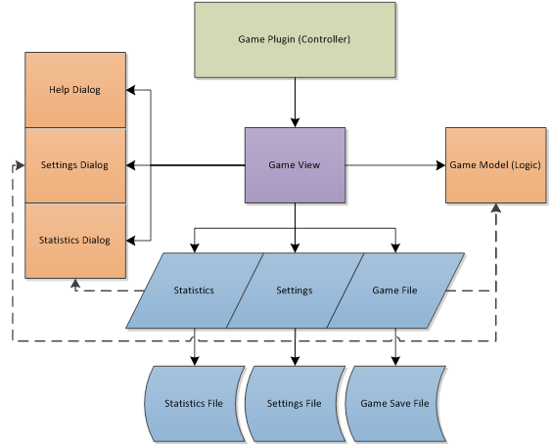
Current STB Framework
Redesign
Game Plugin
Needs to contact Game Server for current list of games
Game View
General Engine that will setup user’s selected game
Game Model
Handles requested game information from server to set up multiplayer communication
Green – Game Plugin
Purple – Game View
Orange – UI Objects
Blue – Data and Data Objects
Notes:
Marshall

Slide 6
Design Analysis – STB (client)
Base game framework
Communications
Command Link
Protocol Buffers
Two generic game UI engines
Board games UI
Card games UI
Only uses gamestate to update UI
No code sent over network
Per game framework
Communications
Command Link
Protocol Buffers
Each game contains its own UI engine
Sends a binary plugin to each STB
Design #1
Design #2
Notes:
Marshall

Slide 7
Decision Matrix
Single UI Engine
No binaries sent over the network
Potentially less stable, since it is generic
Uses significantly less memory
However, might be much more difficult to implement new games
Individual Game Engine
Not binary compatible
Ideally more stable per game
Uses much more network traffic to download binaries
Can use current game development environment
Notes:
Marshall

Slide 8
STB Prototype Video
Notes:
Marshall

Slide 9
Design Analysis - Server
Written in C# under .NET 4.5
Windows server environment
Portable to Azure
SQL database
Facilitates communication between clients
Processes AI for virtual players
Deploys game resources to client
Manages logic for each multiplayer game instance
Error Log to view game crash reports
Notes:
David + Kevin

Slide 10
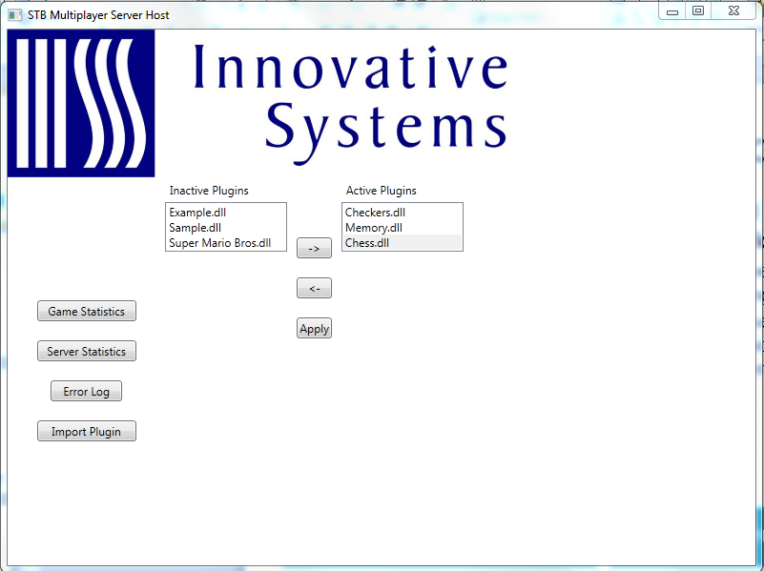
Design Analysis - Server
Notes:
Kevin
Game Stats: for each game, show: total # played, total currently playing, date made (in)active, date imported
Server Stats: Total uptime, Server version, total network traffic
Error Log:
Import login: brings up a file dialog so admin can browse to and add a game file.

Slide 11
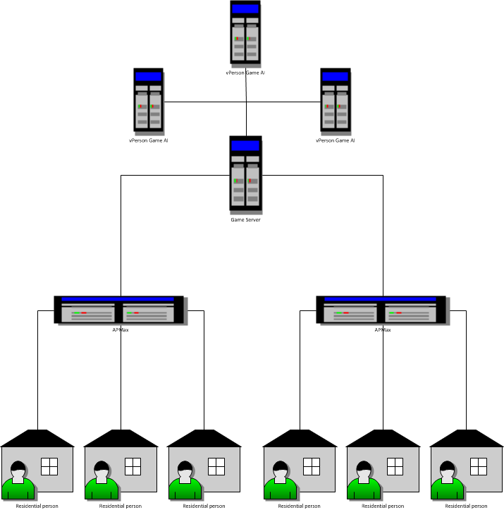
Initial Architecture
Central server
Hosts game files
Connects APMax units
A.I. servers
Optional – If the central server can’t handle all game A.I.
APMax
Middleware
Connects the server to each STB
Client
Set Top Box
Notes:
Kevin

Slide 12
Testing
Full unit testing
Testing Server and STB code
Create a virtual APMax
Used to simulate communication between STB and server
Test new CommandLink messages before going into production
Notes:
David

Slide 13
Constraints
Set Top Box
Low memory (128MB total, 7MB working)
Can’t use flash storage
Low powered processor (800Mhz)
Limited bandwidth usage
Server
Needs to be scalable to 100s or 1000s of users simultaneously connected
Notes:
David

Slide 14
Risks
STB firmware updates during development
Previous project
Should only affect UI engine on STB
Contingency Plan
Update the engine as soon as possible
Changing the game development process
Could increase game development time
Might make debugging even more difficult
Contingency Plan
Build an error logger into the client engine
Send crash reports to the server
Notes:
Risks, risk analysis, mitigation and contingency plan (2 min)
David

Slide 15
Sprints
Sprint 1: September 19th – October 3rd
Deliverables
Initial design document
Initial requirements document
Environment: Setup and Testing
Meeting with STB team from Mitchell
Information exchange
Research
Dynamically load views on STB
Sending game state using Protocol Buffers
Sprint 2: October 10th – October 31st
Initial development
Notes:
Marshall

Slide 16
Backlog Outline
CmdLink Design and Integration
Server Plugin Interface
Research: Server operating systems
Research: Security for the server
Research: UDP vs TCP
Research QML
Server Tests
Server Logic
Server-Game plug in Interface
Server Communication
Prove out and implement QUiLoader
Build Template STB GUI
Implement Virtual APMax
Design CmdLink message formats
Design Protocol Buffer message structure
Notes:
Quickly show that we have a backlog, no need to go into great detail here
Kevin

Slide 17
Questions?
Notes:
Questions (5 mins)
David, Kevin, Marshall

